Slide 1
ONLINE
HOSPITAL INFORMATION SYSTEM
PRESENTED BY:
SANDEEP KUMAR GUPTA
B.C.A 5th SEM.
PROJECT GUIDANCE: Mr.R.K.Pandey

Slide 2
CONTENTS
Introduction
Aim of the Project
System Requirements
Modules

Slide 3
Introduction
Hospitals are essential part of our lives , providing best medical facilities to people suffering from various disease.
Hospitals are the institution providing medical and surgical and nursing care for any sick or injured people.
It is a Temporary space occupied by sick or ill patient.

Slide 4
Aim of the project:
    Basic requirements for the hospital patient information system.
    Provide functionality to patients.
    Patients may registered by anywhere.
    No time consuming in treatment.
    Maintaining ,searching ,editing patients /doctors details.
    Report generation

Slide 5
SCOPE:
The proposed software product is the hospital information System.
The system will be used to get information from patients and then stored in database for future usage.
The systems are to reduce over-time pay and increase number of patients that can be treated accurately.
Can be used in any Hospital ,Clinic , Dispensary for Maintaining Details and their results.

Slide 6
Existing System
Lack of immediate Retrievals.
Lack of immediate information storage.
Lack of Updating.
Preparation of accurate and well Reports.

Slide 7
Proposed System
Immediate of Access of data.
Friendly user interface.
Time Saving.
Data can be easily inserted/updated/deleted.
Give facility of different types of Enquiry.

Slide 8
minimum requirements
Hardware Requirements
  Intel Processor Pentium 4
  RAM 512 MB.
Software Requirements
  Operating System – Windows 7 or above.
  Browser supported by Internet Explorer, Google Chrome, Mozilla, Firefox

Slide 9
Technologies used
Front End:
HTML , CSS , Bootstrap
Java Server Page
Back End:
Oracle Database
Development Tools
Apache Tomcat

Slide 10
Modules
    Home
    Registration
    About us
    Doctor List
    Appointment
    Patient Detail
    Center
    Contact us
    Admin

Slide 11
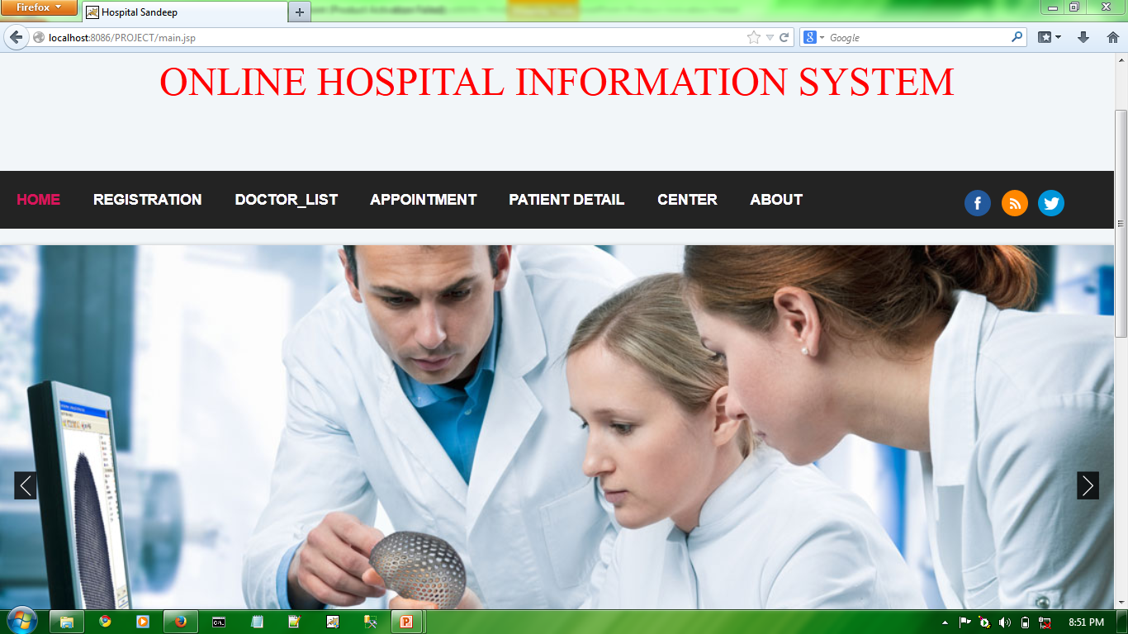
Home Page

Slide 12
Registration
Registration has been make by newly Patients.
He / She Entered All personal Details .
If he Older Patient then Go to the Appointment and enter your PHN generated after Complete Registration .
Go to the Appointment for Further process.

Slide 13
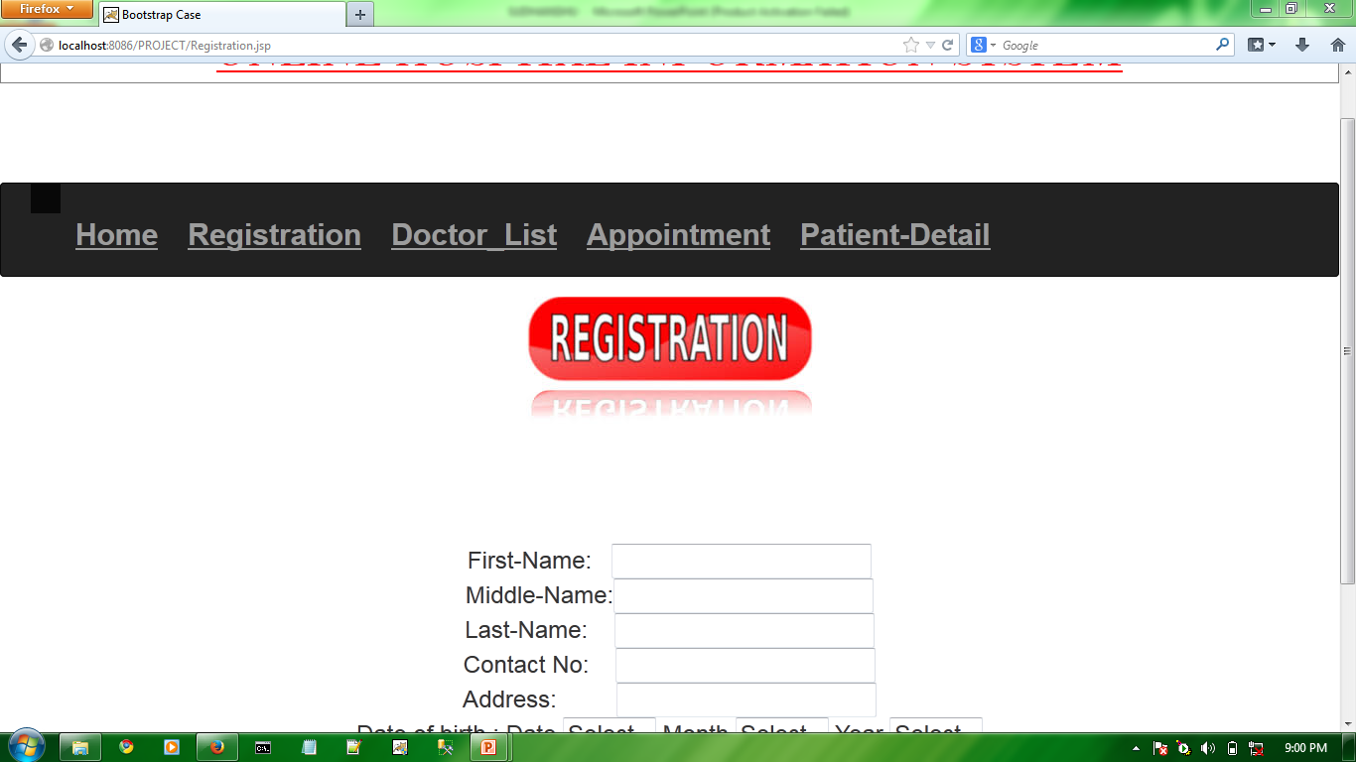
Registration page

Slide 14
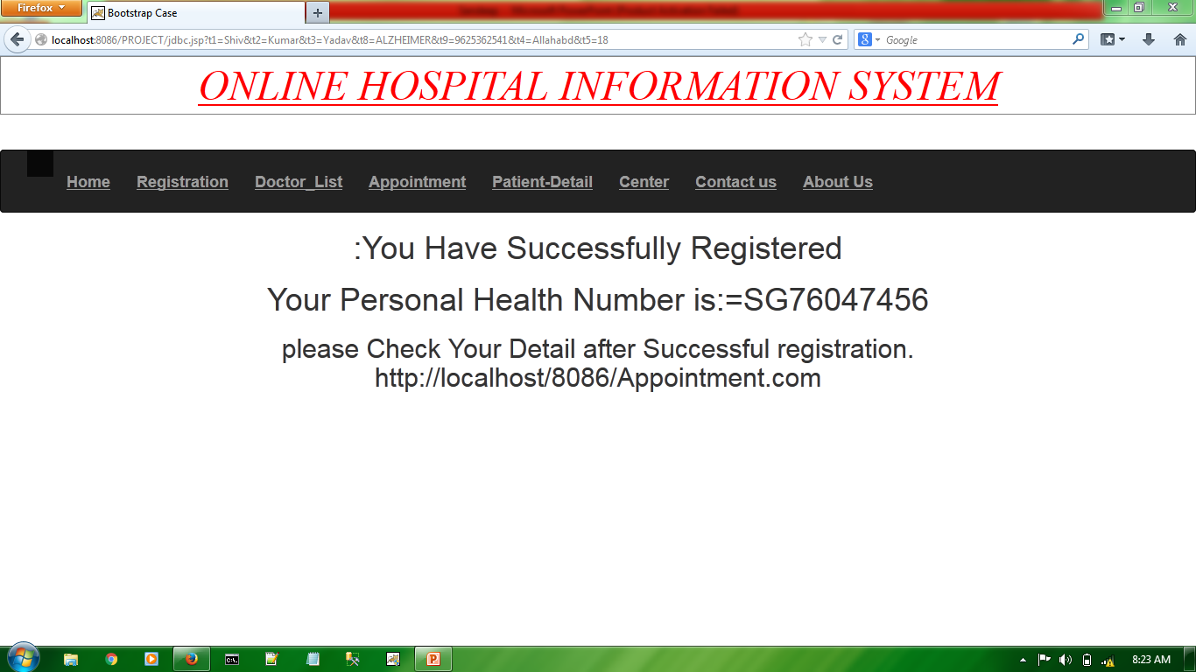
Generating PHN Number

Slide 15
DOCTORS
OPTOMETRIST
E.N.T (OTORHINOLARYNLOGIST)
BONE SPECIALIST
PEDIATRIST
WOMEN SPECIALIST

Slide 16
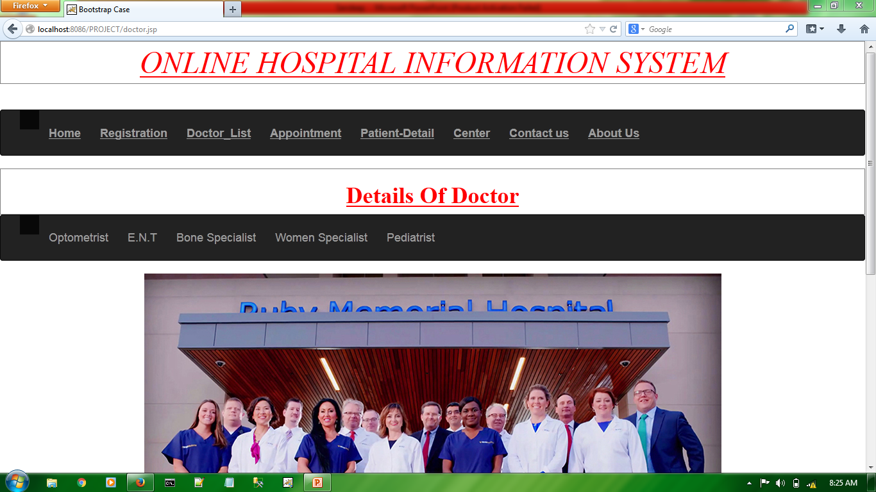
Doctors list

Slide 17
Appointment
Patient first Enter the PHN number.
If He Appointed by doctor then date , time and name of the doctor should be show.
Other a message will be show . Please Wait…..

Slide 18
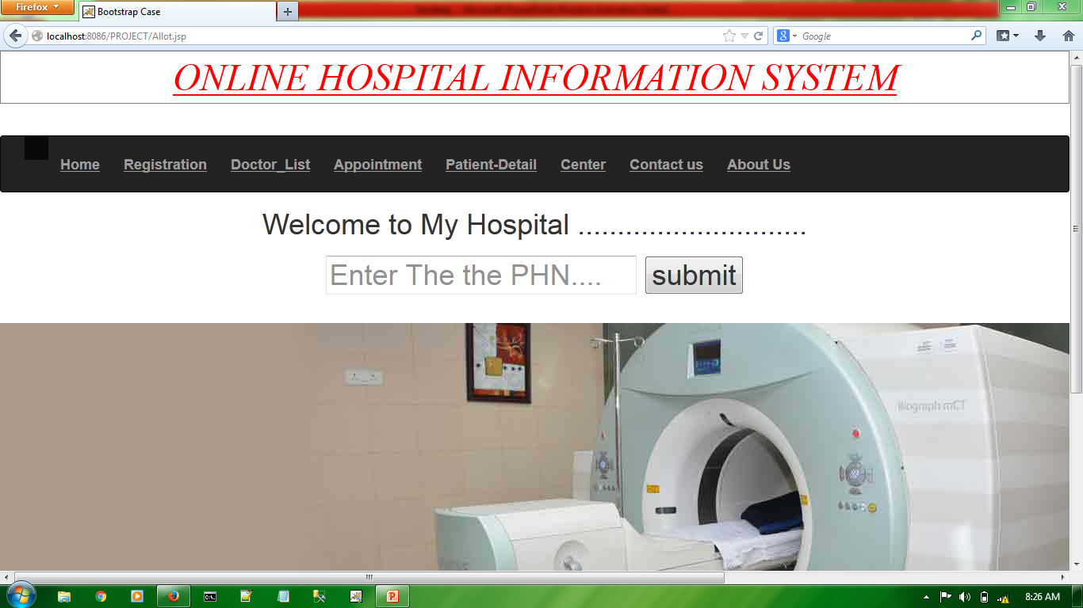
Appointment process

Slide 19
PATIENT DETAIL
Contain details of patients.
Name , Phone number , Problem , Gender etc.
Date of Admitted.
Date of Discharge.

Slide 20
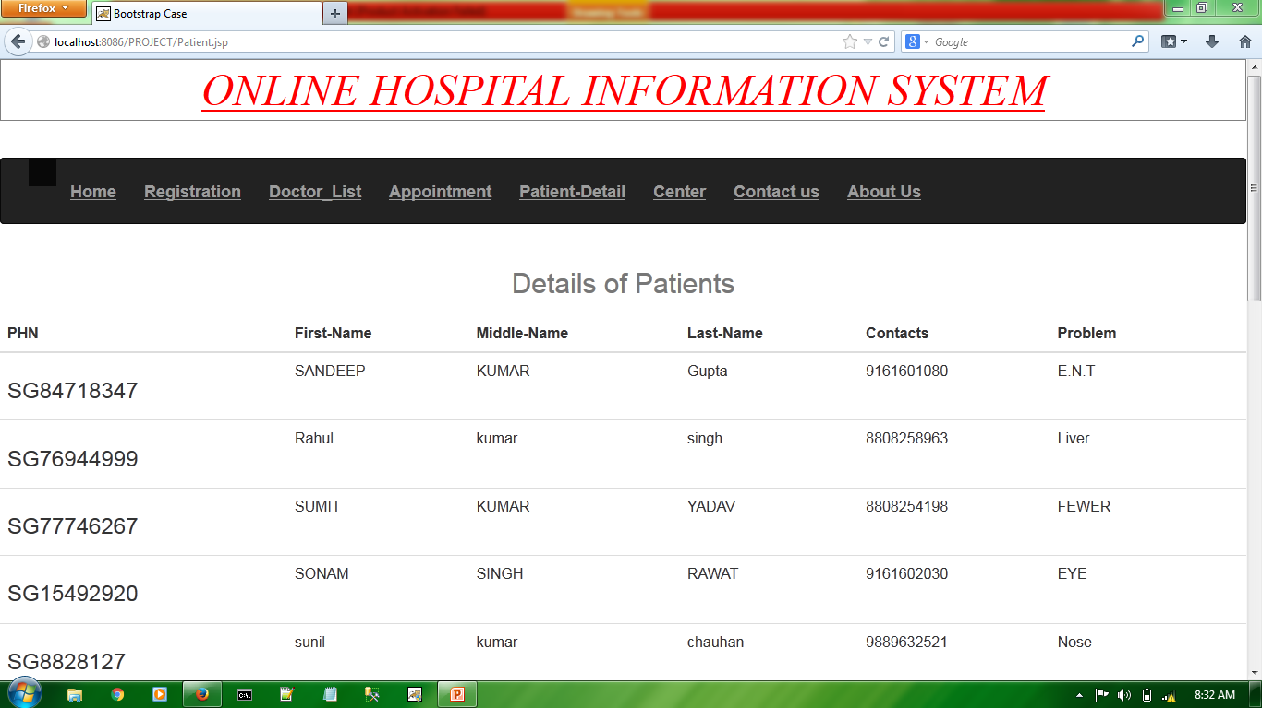
Details of The Patient

Slide 21
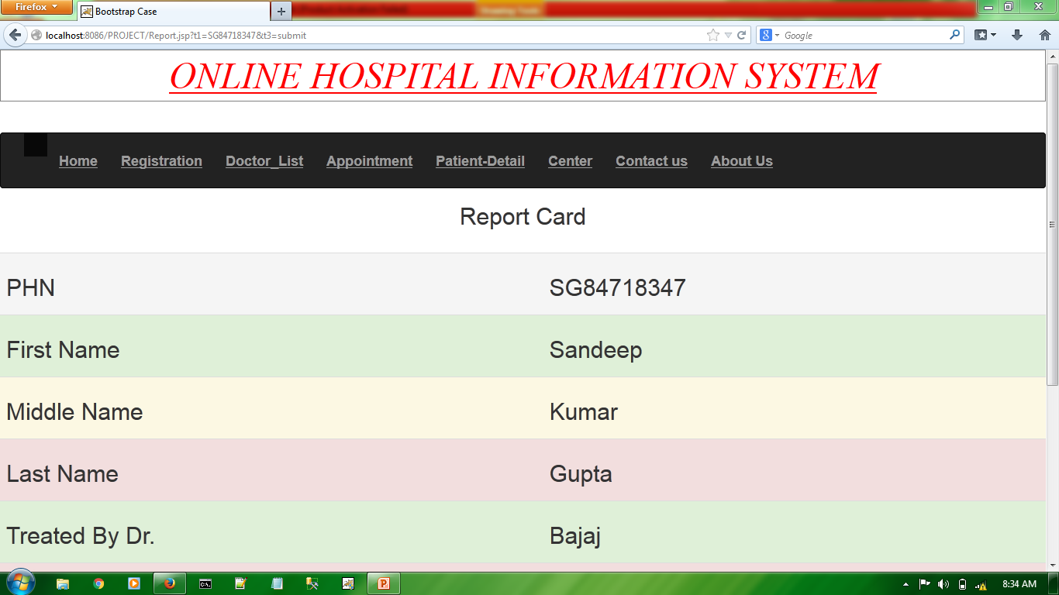
Report Card

Slide 22
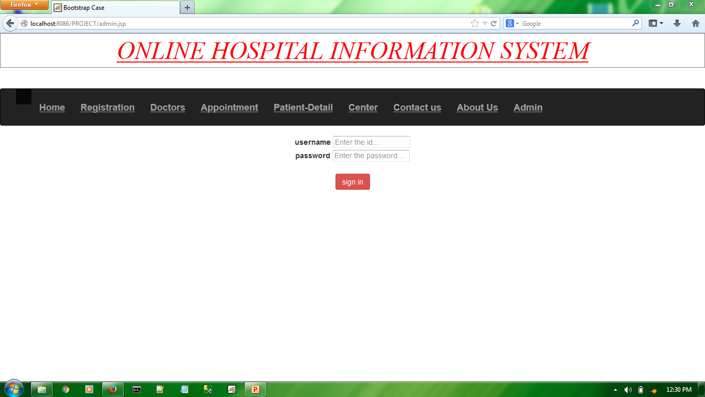
Administrator

Slide 23
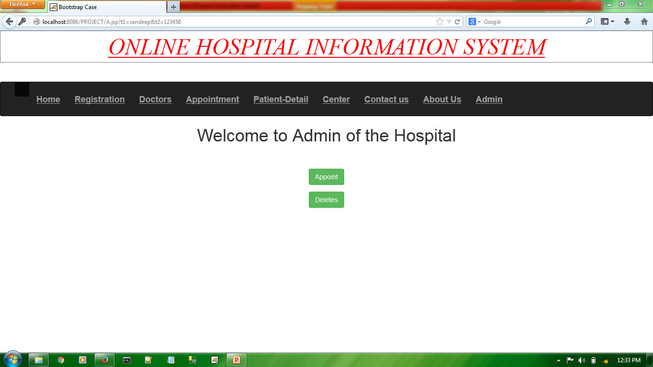
Appointing , Deleting ,Updating Patient Record

Slide 24


